Slide 1

Inference
Testing Hypothesis about Proportions
Adriano Zambom

Slide 2
Hypothesis Testing Steps
Step 1: Determine the null and the alternative hypothesis
Step 2: Verify the conditions, and if they are met, calculate the test statistic
Step 3: Assuming that the null hypothesis is true, find the p-value
Step 4: Decide whether or not the result is statistically significant based on the p-value
Step 5: Report the conclusion in the context of the situation
Adriano Zambom

Slide 3
Hypothesis
Null hypothesis (H0): A statement that there is nothing happening.
Alternative hypothesis (Ha): A statement that something is happening. Usually, what the researcher hopes to prove.
Example: Suppose that a pharmaceutical company wants to be able to claim that for its newest medication the proportion of patients who experience side eﬀects is a minority.
H0 : p < 0.5, population proportion is minority
Ha : p >= 0.5, Alt hypothesis is oposite of null hypothesis
Adriano Zambom

Slide 4
More about Hypothesis
In a hypothesis test we can only assess whether or not the observed data are consistent with the null hypothesis. If not, we reject the null hypothesis. If yes, then we do not reject the null hypothesis.
When the alternative hypothesis is single direction, the test is called a one-sided or one-tailed hypothesis test.
  H0: on average, men and women have the same strength
  Ha: on average, men are stronger then women
When the alternative hypothesis includes both directions, the test is called a two-sided or two-tailed hypothesis test.
  H0: the proportion of men and women with high blood pressure is the same
  Ha: the proportion of men with high blood pressure is not equal to the proportion of women
Adriano Zambom

Slide 5



P-value
Interpretation: Assuming the null hypothesis is true, the p-value is the probability of a result as extreme (or more extreme) as the observed test in the direction of the alternative hypothesis.
Calculation:
  1. z or t = (statistic – null value) / std.error
  2. find the probability in the z or t table
Conclusion:
  If then reject the null hypothesis
  If then do not reject the null hypothesis
  Level of Significance:
  If you choose 95% confidence then
Adriano Zambom

Slide 6

Errors and Power
Type I Error: occurs when we conclude to reject the null hypothesis, when it is actually true. The probability of conducting a type I error is always equal to the signiﬁcance level
Type II Error: occurs when we conclude not to reject the null hypothesis, when it is actually false.
The power of a test is the probability of making the correct decision when the null hypothesis is false.
  power = 1 – type II error
Adriano Zambom

Slide 7


Hypothesis Test for One Sample Proportion
Conditions:
1. Independent trials
2. and
Adriano Zambom

Slide 8

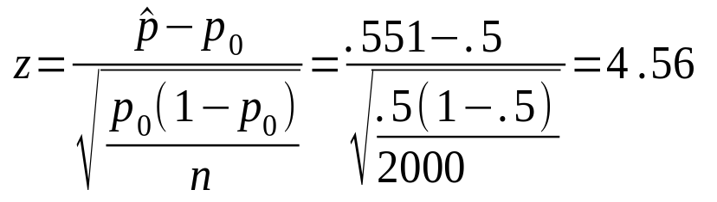


Example
In a survey to study the proportion of people in favor of death penalty, of the 2000 surveyed, 1102 said yes. Is the majority of people in favor statistically speaking?
Step 1:
  H0: p = 0.5
  Ha: p > 0.5 Note:
Step 2:
Adriano Zambom

Slide 9

Example(continued)
Step 3:
  p-value = P(Z > z) = P(Z > 4.56) = 0.0000025
Step 4:
  p-value = 0.0000025 <
  Hence reject the null hypothesis
Step 5:
  Conclusion: With 95% confidence, we have enough evidence to reject H0, and so we have enough evidence to say that the majority of people is in favor of death penalty
Adriano Zambom

Slide 10
More on the Example
What would be the p-value if we want to test whether
A) the minority is in favor?
B) the majority or minority is in favor?
Adriano Zambom

Slide 11
Hypothesis Testing for the Diﬀerence of Two Population Proportions
Conditions:
Independent samples from the two populations.
The number with the response of interest and the number without the response of interest is at least 10 in each sample.
Adriano Zambom

Slide 12


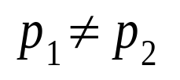
Example
We want to test if the proportion of men who become bald is different then the proportion of women. Of the 1000 men surveyed, 78 became bald, and of the 980 women, 15 became bald.
Define:
  = proportion of men bald in the entire population
  = proportion of women bald in the entire population
Step 1:
  H0: =
  Ha:
Adriano Zambom

Slide 13
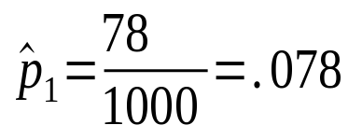
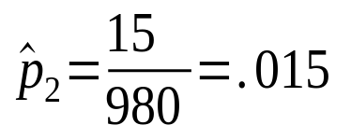
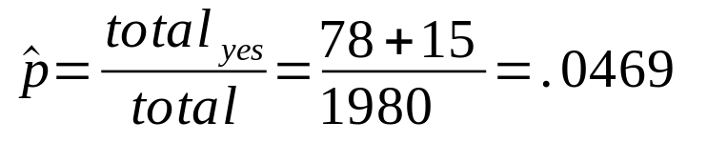
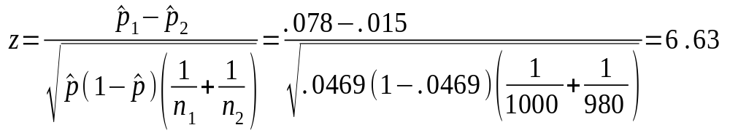
Example
Step 2: conditions are met. Calculation:
Step 3:
  P-value = P(|Z| > z) = P(|Z| > 6.63) = .000000000035
Step 4:
  P-value < 0.05 then reject H0
Step 5: we have enough evidence to say that with 95% confidence, the proportion of men that become bald is different of the proportion of women.
Adriano Zambom

Slide 14
Example
What if we want to know whether
A) the proportion of men is greater than the proportion of women?
B) the proportion of men is less than the proportion of women?
Adriano Zambom

